Slide 1




Pacific School Of Engineering Surat
Submitted by :
Poriya Rutvik 211120107024
Rathod Akshada 211120107009
Nayka Mahima 211120107016
Vaghasiya Harsh 211120107004
Guided By :- Devkishan Patel
Project Name:
ONE STEP AHEAD TOWARDS TO HUMANITY

Slide 2
Project Introduction
The Donation Website Project aims to make giving back easy and accessible. Our user-friendly platform lets you quickly and securely donate to various causes. Browse through different charities, click to donate, and track your contributions in real-time. With a simple design and secure payment options, we're making it effortless for you to make a positive impact and support the causes you care about. Join us in making a difference today.

Slide 3

Importance Of Donation Website
The Donation Website Project is crucial in bridging the gap between generosity and impact. By providing a convenient online platform for donations, it empowers individuals to contribute easily to causes they believe in. This project not only streamlines the donation process but also ensures transparency and accountability, allowing donors to witness the tangible results of their generosity. In a world where every contribution matters, the Donation Website Project serves as a catalyst for positive change, making philanthropy accessible to all and amplifying the collective impact of giving.

Slide 4
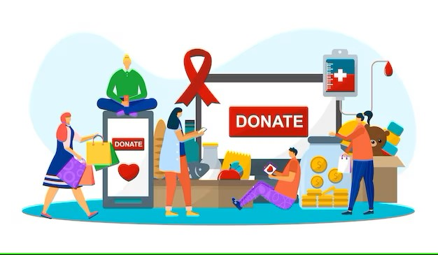
Why This Project ?
A Donation Website is essential because it makes giving simple and accessible. It allows people to contribute to causes they care about easily, eliminating barriers and encouraging broader participation in philanthropy. The website's transparency and real-time tracking build trust between donors and charities, while its user-friendly design makes the donation process straightforward. In essence, a Donation Website connects donors with impactful causes, making it easier for everyone to play a part in creating positive change.

Slide 5
There are Many Fields In Donation.
Hospital Donation
Blood Donation
Animal Donation
Cloths Donation
Crisis Donation
Many More Fields.

Slide 6

What’s New From Other Websites
E Mandate
Online Games and Platforms
Free Study And Education
Home Pickups Cloths And Ration
Map For Nearby Places where Help needed

Slide 7
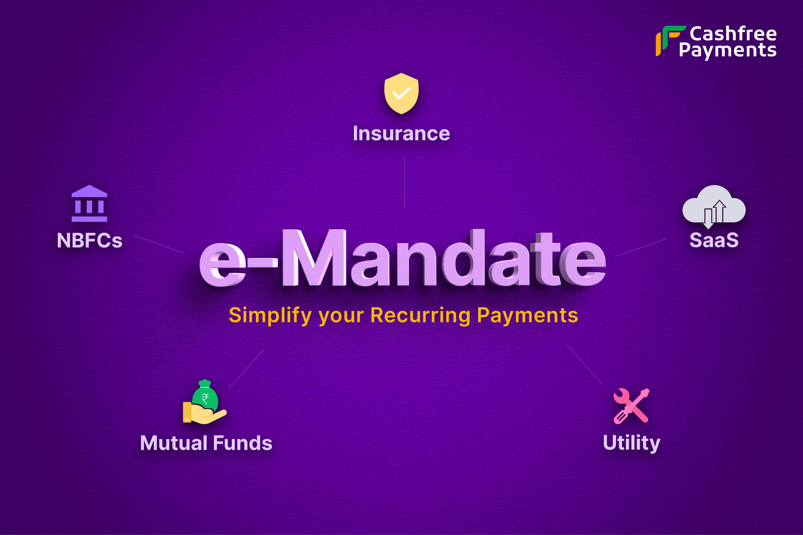
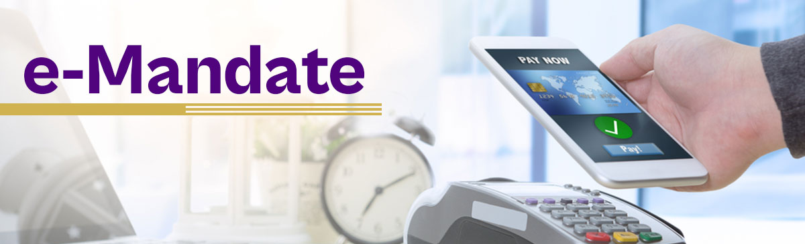
What Is E Mandate ?
E-mandate refers to an electronic authorization or permission given by a person or entity for a specific action or transaction. Instead of using traditional paper-based forms, e-mandates are created and managed digitally. This could include authorizing automatic payments from a bank account, giving permission for online transactions, or allowing a service provider to access certain information electronically. E-mandates streamline the process, making it more convenient and efficient compared to traditional paper methods.

Slide 8
Online Games And Platforms
There are Some Games That Can Helps to Create Money By just Playing Online.
By Playing In Website It shows Some Ads that Pay for that and this also used in Donation.
Platforms Like Youtube And some Streaming Platforms are provided In this website and Just by watching Videos and survey the platform the Ads are shown to user.

Slide 9

Free Study and Education
In This Website We Can Provides Videos for Particular Subjects and Courses for Free For those Who really wants to Study.
For This Filed Also Doner Can donate For the Higher Study and Improve Courses and Helps to Create More Study Materials.

Slide 10

Home Pick Up Cloths
We Provide Home Pickup Facilitys For Cloths And Ration.
User Just have to Give the address for to pick up Cloths and Ration
We also provide Nearby Map Locations where they can go and Donate the Cloths and Rations To Old Age or Orphanage.

Slide 11

Map For Nearby Places where Help needed
We Provide Map That User Just have to Select There City and Area then it Shows all nearby Places Where Help Needed Like Old Age Homes or Orphanage any many other Charitys.

Slide 12
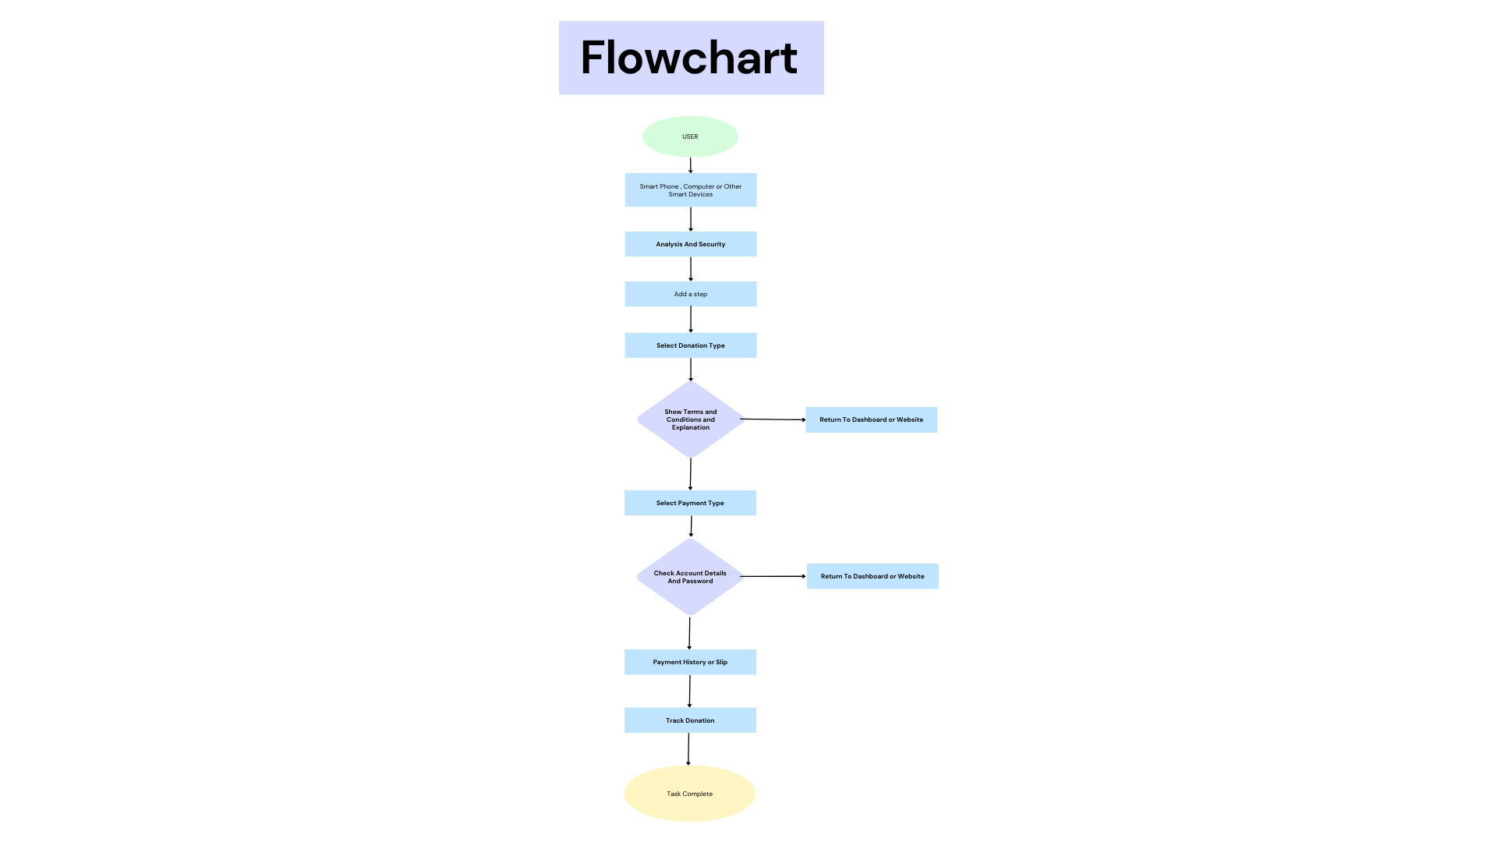

Slide 13
Conclusion
the donation website project aims to simplify and enhance the giving experience. With user-friendly features, transparent tracking, and real-time impact updates, it encourages people to contribute to causes they care about. Security measures ensure donor information is protected, fostering trust. Ultimately, the project aims to create a sense of community and collective responsibility for positive change.

Slide 14
Thank you

